Slide 1
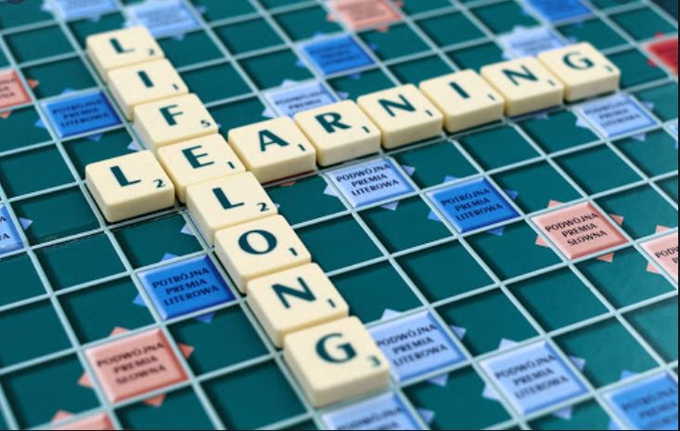
Education and Lifelong Learning Advisory Committee
June 8, 2021

Slide 2
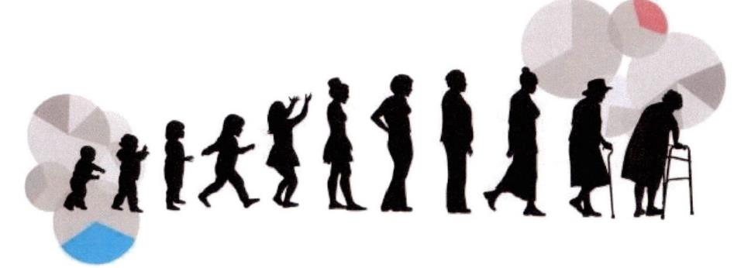
Workshop Purpose
Recap “Where we Left Off.”
Topic Introduction: Inclusion and Equity aspect of ELL.

Slide 3
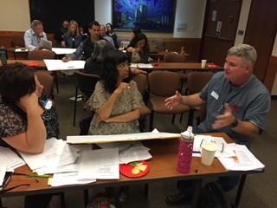
What is ELL ?
Parent Education
Arts for all Age groups
Cultural Celebrations
Include Youth in Governance “Youth Commission”
Outreach, Inclusiveness with marginalized communities
Health advocacy training
Education about Napa River
Newell Open Space Education Facility
And Many Others!

Slide 4
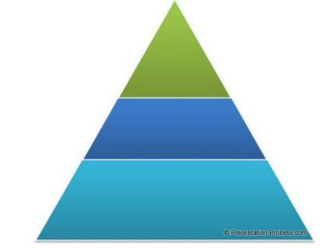
ELL Providers:
Geographic location expands: City – Partner- Autonomous.
Providers are dynamic. Ie: services provided by City may be provided by partner. Partner may become fully autonomous and vice versa.
City
City Partner
Autonomous from City

Slide 5
ELL Providers:
Autonomous provider may partner with City for specific purpose for a limited time.
City
City Partner
Autonomous from City

Slide 6
NVUSD Property Locations
NJ Elementary
New Elementary
Donaldson Way
High School
AC Middle
Silver Oak
Middle

Slide 7
City Coordination with NVUSD
General Plan land use designation consistent with the use (ie: AC Middle School is designated Residential, new Elementary School is designated Commercial Recreation)
The District may want surplus properties redesignated (ie: Surplus Middle School site is designated Public)
The City meets with the NVUSD to discuss citywide land use designations and new project applications on student generation impacts.
School District interest in the Circulation Element i.e.: new planned roadways.

Slide 8
ELL Element Components
American Canyon ELL Element
Vision
Foster an ELL Environment so all residents gain knowledge and learn new skills throughout their life
Broad
Guiding Principles
Enable residents to access the broadest possible source of ELL resources
City
Goals
Enrich life
Improve health
Increase social awareness
City Partner
Policies
Identify methods under control of the City to achieve goals.
Implementation Programs
Establish administrative procedures to make policies happen.
Specific

Slide 9
Group Discussion
Questions before moving on to today’s topic?

Slide 10
My Brother’s Keeper Initiative
A partnership between the (MBK) Alliance and the National League of Cities.
Equity and Leadership (REAL) REAL “Compass” initiative report shows that lifelong education intervention for Historically Marginalized boys and men of color can have a positive impact on life outcomes.
Historically Marginalized people also includes race, ethnicity, gender, age, religion, immigration status, sexual orientation, socioeconomic status, and many others.

Slide 11
ELL Inclusiveness Principles
Equity and Inclusiveness is a right many of us enjoy.
An environment in which any individual or group can be and feel welcomed, respected, supported, and valued in full participation.
Advances in societal inclusiveness has improved lives for many people i.e. Americans with Disabilities Act.
Inclusiveness can be a sensitive issue for many reasons.
Assume everyone participating has good intentions.
Group Discussion: Changes or additions to Inclusiveness Principles?

Slide 12
Equity
An inclusive society that enables everyone to participate, prosper, and reach their full potential.
Equity is different from equality.
• Equality aims to ensure everyone gets the same things, no matter their starting place.
• Equity involves people having what they need to enjoy full, healthy lives.
Historically marginalized people may need different types or amounts of resources to support and enjoy full, healthy lives.

Slide 13
Inequality
Inequity doesn’t happen by chance. Rather, it is a legacy of intentional and unintentional – maybe even well-meaning- laws, policies, and practices that perpetuate harm to low-income people, communities of color, and other marginalized groups.
Inequality leads to disparities that can be seen in many cities and communities.
There is a growing awareness related to our health and the places we live i.e. cities that have historically allowed noisy, polluting uses and highways in low income areas.

Slide 14
ELL and Inclusion Connection
Education is highly valued in American Canyon and a cornerstone of the quality of life enjoyed throughout the City.
Group Discussion: Are there any Historically Marginalized individuals or groups in American Canyon that we should reach out to?

Slide 15
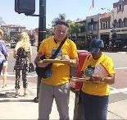
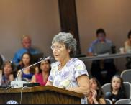
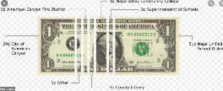
ELL Path to Inclusion
Procedural Equity
Transparent, accessible, fair, and inclusive public decision-making (i.e.: public meetings, notification, outreach).
Structural Equity Government institutions and systems have the 1) Processes, 2) Practices, and 3) Policies to incorporate equity in the City’s Decision-making process. (i.e.: formal public hearings, adopted guidance policies, and others).
Distributional Equity An equitable distribution of resources, community burdens, and benefits. (i.e.: State-mandated programs, City allocation policies, fee and tax programs, and budget process to fund specific programs).

Slide 16
Group Discussion
Group Discussion:
What efforts could each of the three Equity Components contribute to greater Equity in the General Plan ELL Element?
Are there other components on the Path to Equity that should be identified?

Slide 17
Next Steps
Next Steps (for next meeting)
Group Discussion:
What ELL policies would improve each of the three Path to Equity Components?
What groups are missing from the conversation?
Progress “Check-In” with the City Council.
Ideas from the ELL Committee.

Slide 18
Staff Contact
Brent Cooper, AICP
Community Development Director
bcooper@cityofamericancanyon.org
(707) 647-4335
Creighton Wright
Parks and Recreation Director
cwright@cityofamericancanyon.org
(707) 647-4568
Jennifer Kansanback
Community Outreach Manager
jkansanback@cityofamericancanyon.org
(707) 647-5355
Nicolle Jones
Administrative Technician
njones@cityofamericancanyon.org
(707) 647-4348

